Slide 1


Great Energy Predictor III
EE258 - Neural Networks Project 2
Under the guidance of Prof. Birsen Sirkeci
Team Members:
Dhananjay Bajpai(013851812)
Aniket Phatak (012564994)

Slide 2
Overview
Purpose:
Accurate prediction of metered building energy usage in different areas i.e. chilled water, electric, natural gas, hot water and steam meter
To build a baseline model by parameter tweaking to achieve a RMSE less than 0.90
Approach:
Utilize Kaggle kernel and their free cloud- based GPU’s
LGB model (ideal for very large datasets)
Parameter Optimization

Slide 3
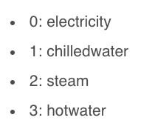
Dataset
5 .csv along with a sample submission file
train.csv: Consists of building id , meter id code timestamp and meter-reading
building_meta.csv: Information on available buildings
weather_train/test.csv: Weather data from a meteorological station as close as possible to the site.
test.csv: Get Predictions in correct order.

Slide 4
Baseline Model
1
2
3
4
5
Import necessary Libraries & Modules
Load Dataset
Data Preprocessing align timestamp, Fill Nan's
Delete unnecessary data frames to reduce memory usage
Data Visualization
Feature Engineering
Build LGB model
Training
Result
6
7
8
9

Slide 5
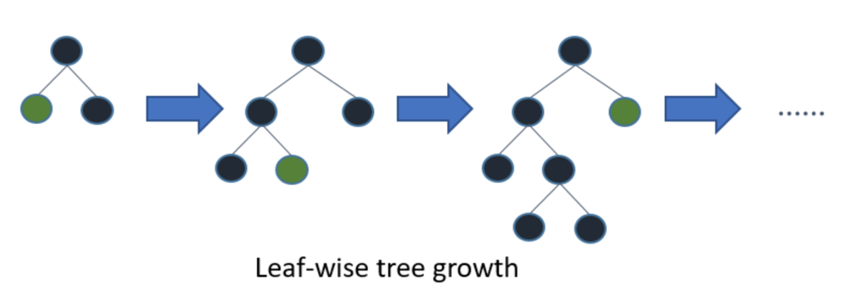
Model: Light Gradient Boosting (LGB)
Grows tree leaf wise(vertically) hence able to reduce more loss than a level-wise algorithm
Ideally suited for datasets with 10,000+ rows
Ability to tweak more than 50 parameters via Python API
Suitable for GPU based learning ~ ideal for large machine learning models

Slide 6
Parameter Selection
Parameter Tuning | Preliminary Baseline values utilized for default Model
Boosting Type | Gradient Boosting {‘dart’ , ‘rf’ , ‘goss’}
Metric | RMSE
Learning Rate | 0.25
Objective | Regression
Subsample | 0.4
L1/L2 Regularization | L2
Early Stopping | 100

Slide 7
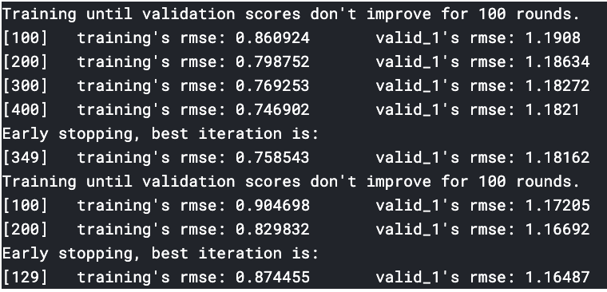
Training Results
With early stopping rounds set to [100], the best training as well as validation results are obtained at [129]
Training RMSE = 0.874455 ; Validation RMSE =1.16487

Slide 8
Conclusion
Further Improvements:
LGBM+ Half and Half Approach:
The data is split into two based on time. Each half is used as the training data for the model.
K-Fold + LGBM
The data is split into 3 or 4 splits. Each split is used as the training data for the model.
Optimization issues using :
More Compute Power
Further tweaking of LGB parameters
A baseline model using LGB has been successfully built and expected RMSE is achieved

Slide 9

Application
The difference in energy consumption units paid by an end user, who has a retro fitted emission less building model can use our prediction to confirm his savings.
Annual savings = energy bills paid according to our prediction without any modern retro fittings– Energy bills paid with retro fitted model
Pay-for-performance financing, the building owner makes payments based on the difference between their real energy consumption and what they would have used without any retrofits.

